Slide 1
Ryvu Therapeutics S.A.
Current report 17/2025 attachment
June 12, 2025

Slide 2
RVU120
EHA2025 data update
RVU120 program summary
RIVER-81
Next data in Q4 2025
Enrollment in Phase II exploratory parts mostly completed
Three Phase II studies in progress: RIVER-81, POTAMI-61, REMARK
Given emerging data, RIVER-52 deprioritized to focus on other RVU120 development paths
Strong interest from the investigator community
Encouraging safety and efficacy
Safety profile potentially better than in most drugs used in AML
Multiple signs of efficacy in Phase II studies
On track in 2025 for key data
Crucial data readouts expected in Q4 2025
No budget overruns with cash runway to H2 2026
Safety profile confirmed
7 of 27 evaluable patients (26%) with CR/CRi/CRh across cohorts
QD administration results with higher efficacy rate in evaluable patients (50% CR/CRi rate in Cohort 4) and longer durability of responses
Enrollment to Cohort 6 (200mg RVU120 QD + 400mg VEN) ongoing
POTAMI-61
Next data in Q4 2025
Exploratory part enrollment completed
RVU120 feasible and tolerated both as single agent and in combination with RUX
Early signs of clinical activity observed
REMARK
Initial data in Q4 2025
Enrollment completed in May 2025
Primary endpoint will be assessed after 24 weeks of treatment
Interim data analysis planned in September 2025
Initial publication planned in Q4 2025

Slide 3
Favorable safety profile confirmed
RIVER-81
Data Cut-off: May 14, 2025
Preliminary data
TEAEs N (%) | All grades | Grade 1 & 2 | Grade 3 & 4
Nausea | 23 (53%) | 19 (44%) | 4 (9%)
Vomiting | 19 (44%) | 18 (42%) | 1 (2%)
Infections/Infestations | 19 (44%) | 7 (16%) | 4 (9%)
Asthenia/Fatigue | 12 (28%) | 9 (21%) | 3 (7%)
Decreased Appetite | 12 (28%) | 12 (28%) | 0 (0%)
Anemia | 10 (23%) | 1 (2%) | 9 (21%)
Febrile Neutropenia | 9 (21%) | 0 (0%) | 9 (21%)
Constipation | 8 (19%) | 1 (2%) | 7 (16%)
Diarrhea | 5 (12%) | 5 (12%) | 0 (0%)
Thrombocytopenia | 5 (12%) | 1 (2%) | 4 (9%)
Neutropenia | 4 (9%) | 0 (0%) | 4 (9%)
Sepsis/Septic Shock | 4 (9%) | 0 (0%) | 1 (2%)
RVU120 in combination with VEN is safe and tolerated in patients with VEN-failed AML
No DLTs and no study drug interruptions due to adverse drug reactions were observed
No trend for increased toxicity at higher doses was observed during the dose escalation phase
The most frequent TEAEs were nausea/vomiting, manageable with common antiemetics, and infections/infestations
17 patients experienced Grade 5 serious adverse events (SAEs), most commonly pneumonia, sepsis, and septic shock. All were deemed unrelated to RVU120 except for one case of acute cardiac failure that was assessed as possibly related
The safety profile of RVU120 is consistent with earlier phase observations.
The incidence of G5 events is expected in the patient population under investigation.

Slide 4
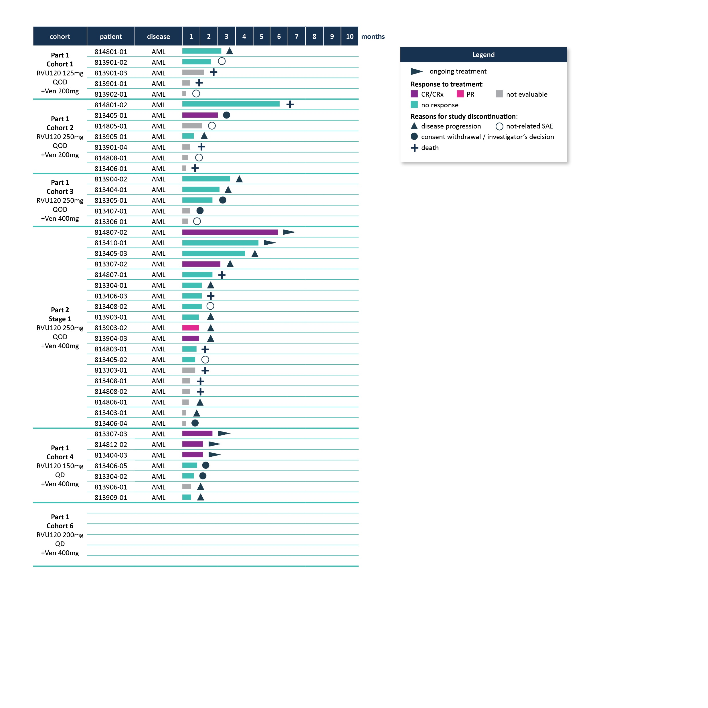
7 of 27 evaluable patients with CR/CRi across cohorts
RIVER-81
Data Cut-off: May 14, 2025
Preliminary data
All responders progressed on prior VEN+HMA therapy, which makes activity of VEN alone very unlikely.
Therefore, the observed benefit must be attributed to the combination of RVU120 + VEN.
3/13 evaluable patients with CRi,
1 pt with PR,
1 pt with >50% blast reduction (43%->6%)
3/6 evaluable patients in Cohort 4 with CR/CRi
Enrollment in progress

Slide 5
RVU120 administered QD associated with higher CR/CRi rate and longer durability of responses
RIVER-81
Data Cut-off: May 14, 2025
Preliminary data
Treatment schedule | Part 1 Cohort 1 RVU120 125mg QOD + Ven 200mg | Part 1 Cohort 2 RVU120 250mg QOD + Ven 200mg | Part 1 Cohort 3 RVU120 250mg QOD + Ven 400mg | Part 2 Stage 1 RVU120 250mg QOD + Ven 400mg | Part 1 Cohort 4 RVU120 150mg QD + Ven 400mg | Part 1 Cohort 6 RVU120 200mg QD + Ven 400mg
Number of patients: total / evaluable for efficacy* | 5/2 | 7/3 | 5/3 | 19/13 | 7/6 | Currently enrolling
CR/CRi in evaluable pts: Number of patients / CR rate (%) | 0 (0%) | 1 (33%) | 0 (0%) | 3 (23%) | 3 (50%)
CR rate in ITT (Intent To Treat) (%) | 0% | 14% | 0% | 16% | 43%
Best response | - | CR | - | CRi, CRi, CRh | CR, CRi, CRi
Duration of response (DoR; days) | - | 45 | - | 38, 38, 154** | 77**, 77**, 56**
* Participants evaluable for efficacy are the ones who have reached at least C2D1 disease assessment. Participants are evaluable for DLT if they have received ≥80% of their planned dose in Cycle 1 or cannot complete dosing due to a DLT event. ** DoR as of May 14, 2025; All patients were still on trial as of June 6, 2025, resulting in a longer DoR
Promising anti-leukemic activity in a subset of patients with a historically poor prognosis.
The observed CR/CRi responses suggest that RVU120 may help overcome VEN resistance.
All responding patients were progressing on their 1L VEN+HMA treatment.

Slide 6
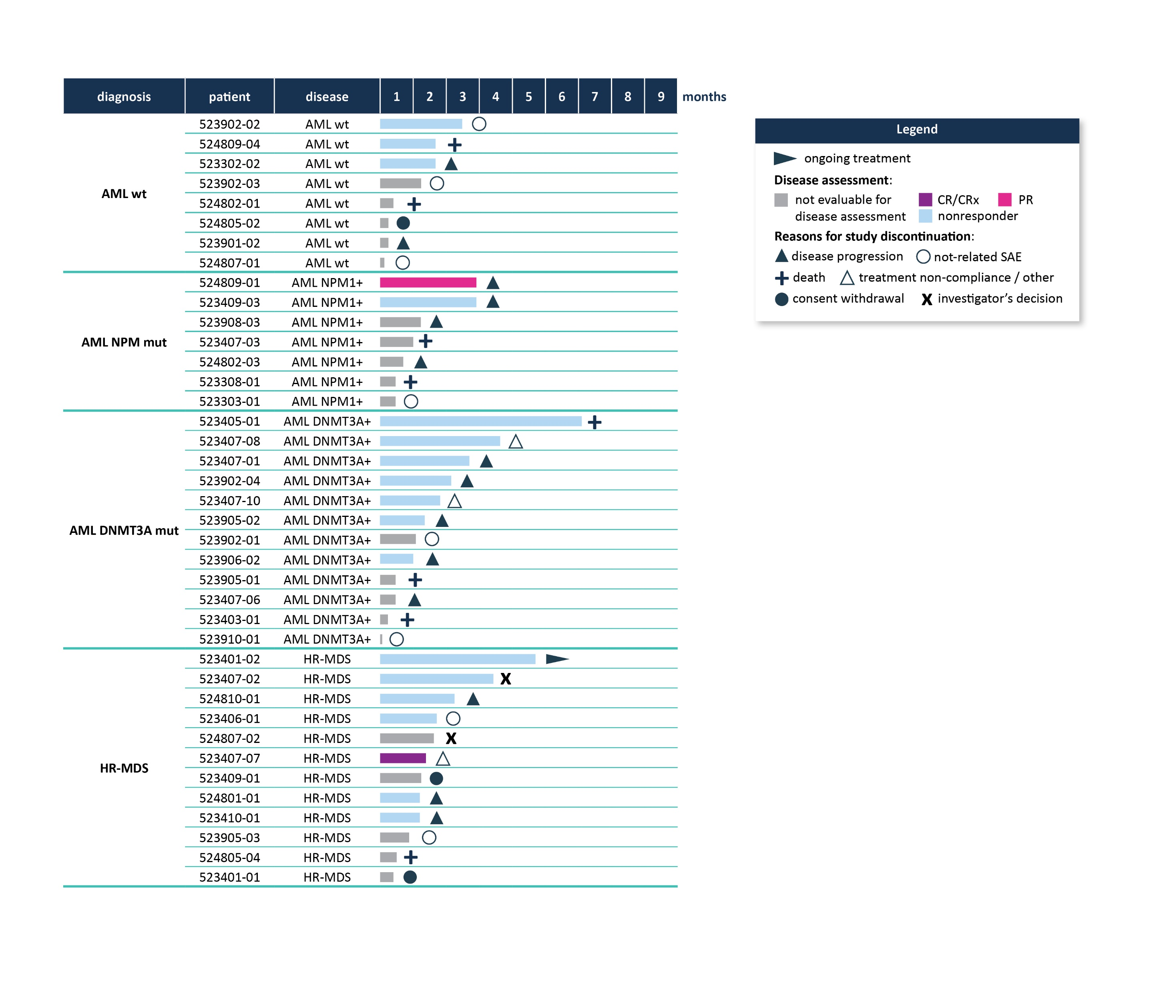
No durable CRs were observed in the treated patients and the study was terminated
RIVER-52
Data Cut-off: May 14, 2025
Preliminary data
Acceptable safety profile at a dose of 250mg QOD.
The data collected will be used to support the safety and efficacy database.
Despite relevant blast reductions in some patients, no durable complete responses were observed in the investigated patient populations.
Although clinical activity of RVU120 as a single agent in patients with AML cannot be excluded, the study was deprioritized.
Enrollment suspended in February 2025

Slide 7
RVU120 in MF is feasible and tolerated both as single agent and in combination with RUX
POTAMI-61
Data Cut-off: May 14, 2025
First data
Treatment Emergent Adverse Events (TEAE) | Any grade n of pts n (%) of patients | Cohort 1 RVU120 n (%) of patients | Cohort 2 RVU120+RUX n (%) of patients
Nausea | 8 (38%) | 7 (33%) | 1 (5%)
Vomiting | 8 (38%) | 5 (24%) | 3 (14%)
Thrombocytopenia | 4 (19%) | 1 (5%) | 3 (14%)
Anemia | 4 (19%) | 1 (5%) | 3 (14%)
Diarrhea | 3 (14%) | 2 (10%) | 1 (5%)
ALP increased | 3 (14%) | 2 (10%) | 1 (5%)
Insomnia | 3 (14%) | 0 | 3 (14%)
Vertigo | 2 (10%) | 1 (5%) | 1 (5%)
Amylase increased | 2 (10%) | 0 | 2 (10%)
ALT increased | 2 (10%) | 1 (5%) | 1 (5%)
Asthenia | 2 (10%) | 1 (5%) | 1 (5%)
UTI | 2 (10%) | 0 | 2 (10%)
Constipation | 2 (10%) | 0 | 2 (10%)
Lipase increased | 2 (10%) | 0 | 2 (10%)
Fatigue | 2 (10%) | 1 (5%) | 1 (5%)
Pneumonia | 2 (10%) | 1 (5%) | 1 (5%)
Headache | 2 (10%) | 2 (10%) | 0
Hypertension | 2 (10%) | 1 (5%) | 1 (5%)
Grade | Number of all TEAEs (%)
1 | 40 (29%)
2 | 72 (53%)
3 | 23 (17%)
4 | 2 (1%)
5 | 0
RVU120 long-term treatment either as a single agent or in combination with RUX is feasible and tolerated
Majority of TEAEs were G1/2 (82%)
Only two G4 TEAEs (anemia, thrombocytopenia) and only two SAEs assessed as study drug related (acute pancreatitis, UTI)
No G5 AEs

Slide 8
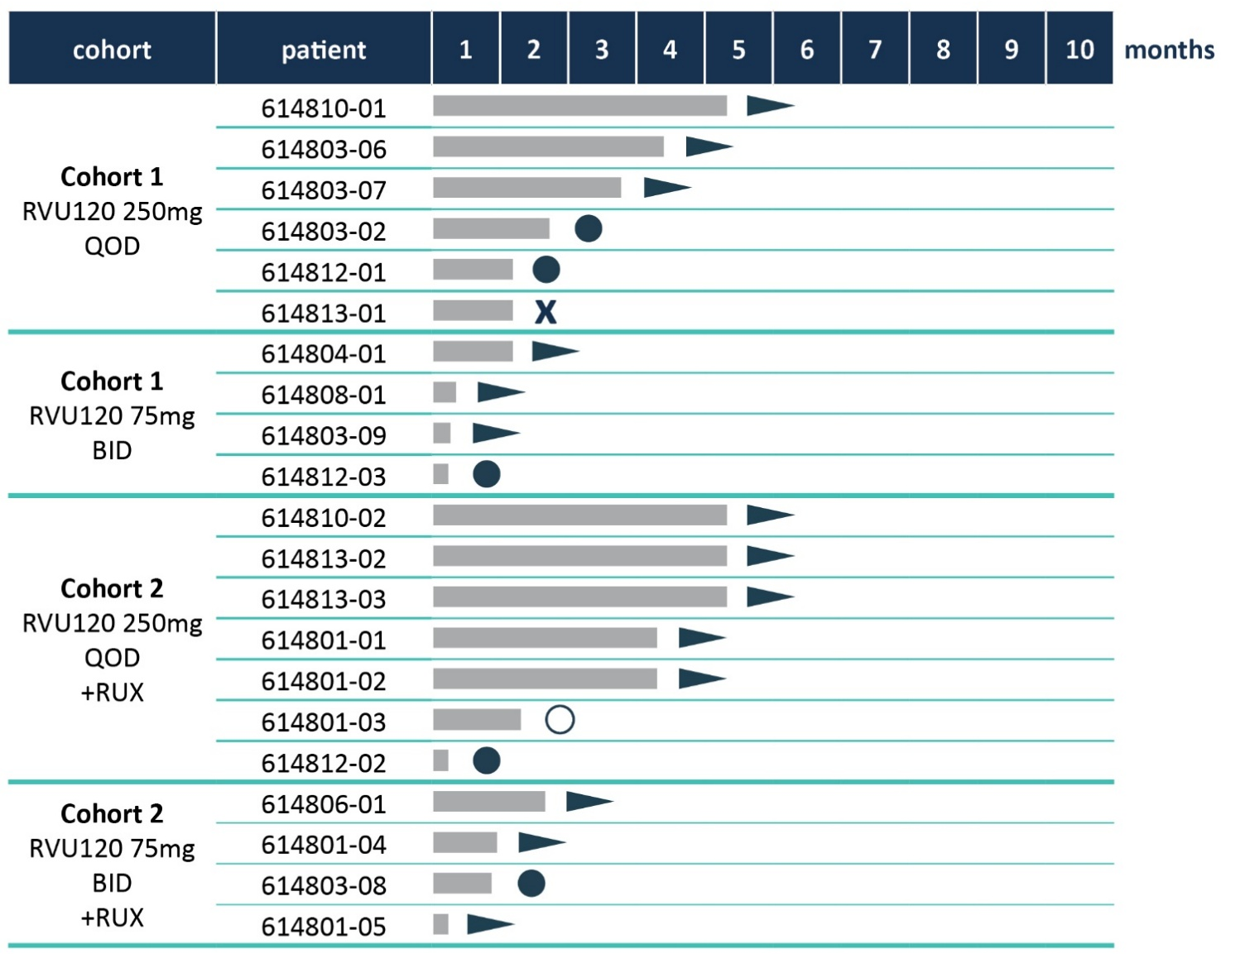
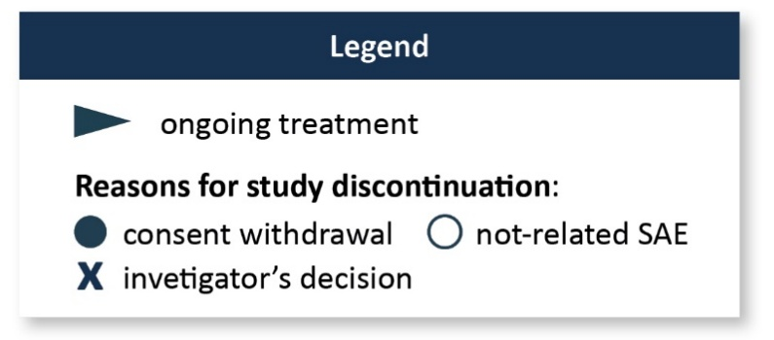
Phase II study of RVU120 in myelofibrosis (MF) shows early signs of clinical activity at 12 weeks
POTAMI-61
Data Cut-off: May 14, 2025
First data
Evaluation time for primary endpoint: 24 weeks
Median time on treatment: 10 weeks
Early readout at 12 weeks
Some patients showed signs of RVU120 clinical activity such as SVR, TSS improvement consistent with preclinical observations
Change of spleen volume
(MRI, SCR vs week 12)
Change of TSS from C1 to week 12 (average of D1-D7 was taken into account)
No patient has yet reached the 24-week evaluation timepoint

Slide 9
RVU120’s possible clinical development program with high commercial potential
 |  | 2025 |  |  |  | 2026 |  |  |  | 2027 |  |  |  | 2028
 |  | I | II | III | IV | I | II | III | IV | I | II | III | IV | I | II | III | IV
Phase II studies in hematologic malignancies
RIVER-81: AML, combination with venetoclax POTAMI-61: myelofibrosis (MF), monotherapy and combination with ruxolitinib REMARK: LR-MDS, monotherapy, investigator-initiated trial (IIT)
Beyond 2028
Exploratory part
Confirmatory part
Phase III (potential for 1L)
Exploratory part
Ph II Part 2
Confirmatory part
Phase III (potential for 1L)
REMARK (exploratory; IIT)
Confirmatory Ph II study
Phase III (potential for 1L)
Approval process initiation in selected regions

